Slide 1
공개 소프트웨어 프로젝트
Team 10 : Smart Album
with Cloud

Slide 2
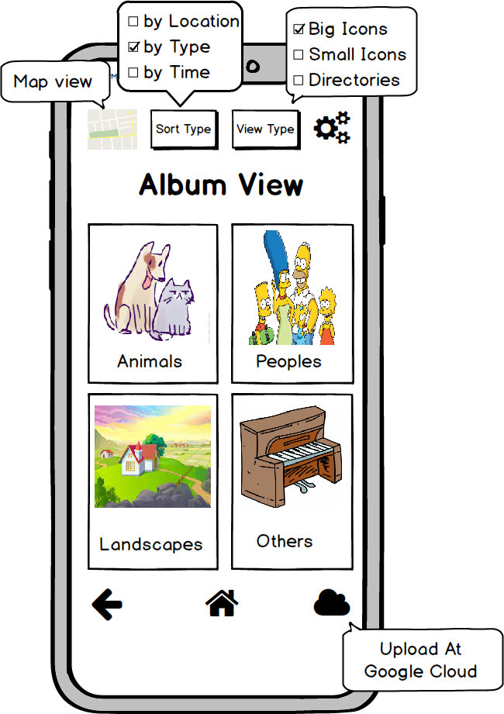
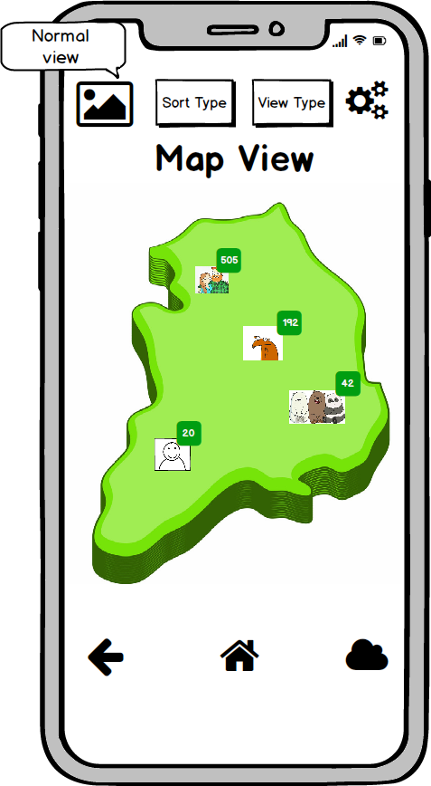

Application Prototype
Simple Design
Using Open Source
Can Upload At
Google Cloud
With Current Settings
Based On
Google Map API
Zoom In & Out
Event-Handling

Slide 3
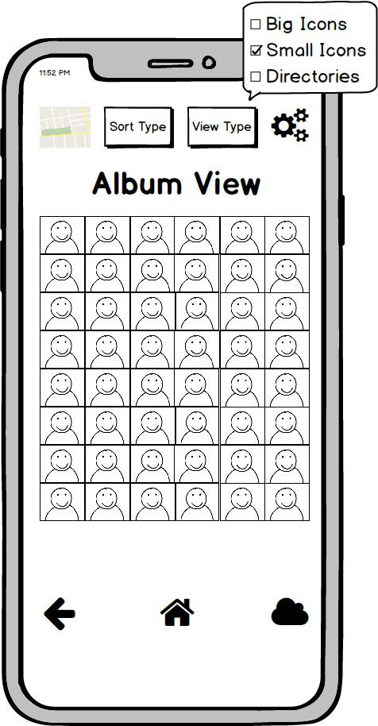
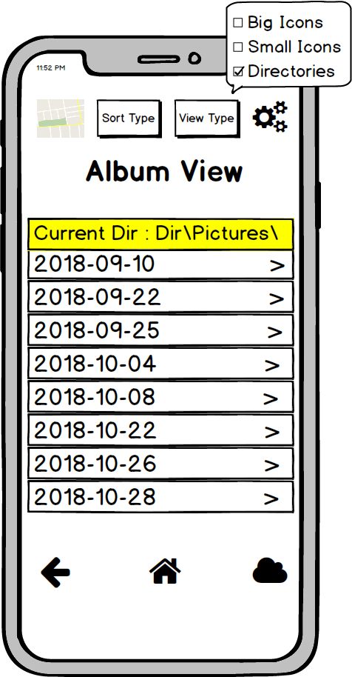
Application Prototype
Categorized By User Settings
- Locations
- Picture Types(Animals, Peoples, ..)
- Time Order

Slide 4
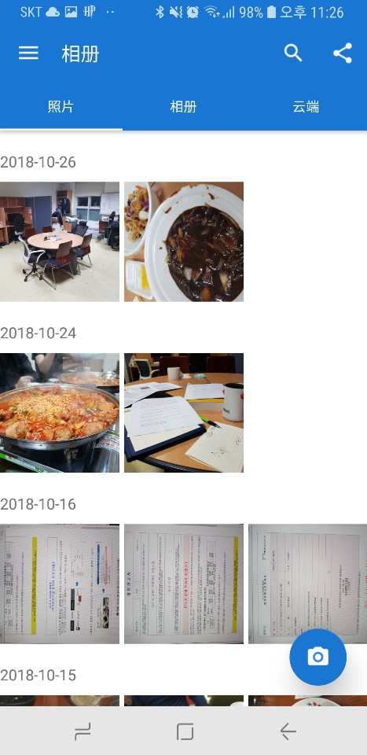
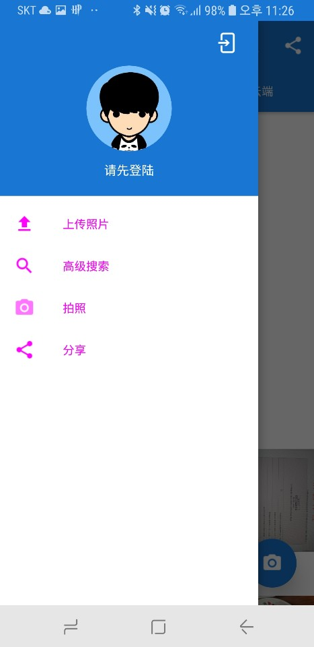
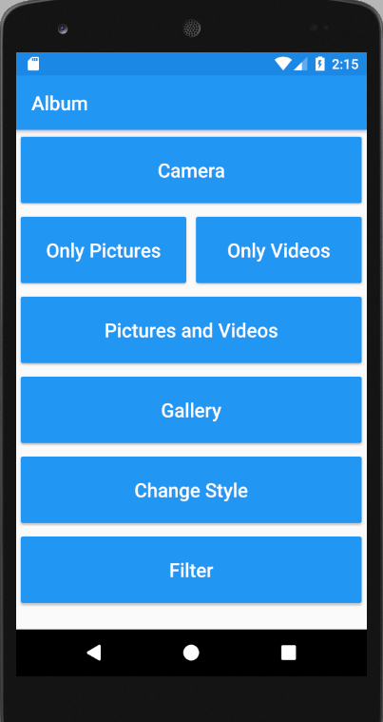


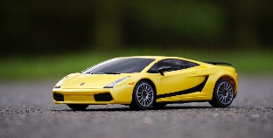
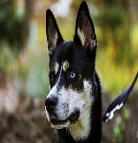


OpenSource App -
A Simple Style Album App
- Preview pictures and videos
in the gallery or select
pictures and videos in the gallery
- Take a picture, record a video,
or use camera in album list

Slide 5
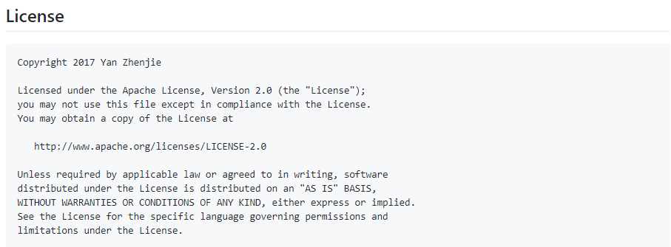
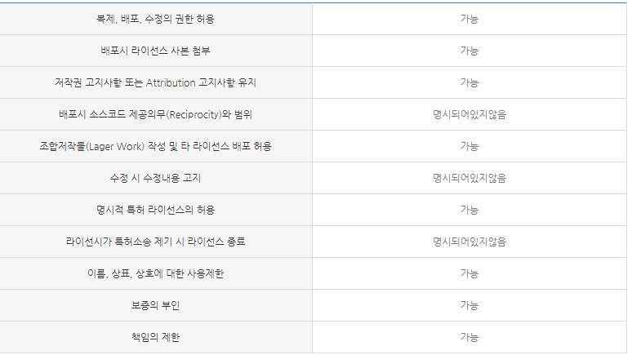
OpenSource App -

Slide 6
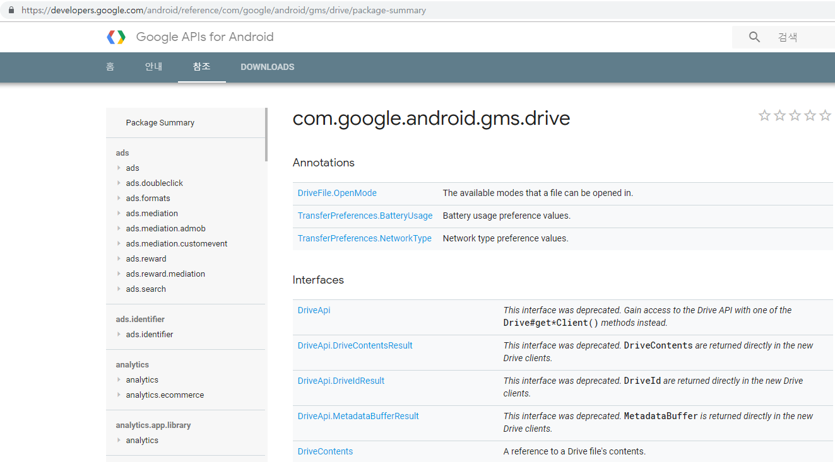
OpenSource APIs – Google Cloud & Google Map
Can easily get information
(classes, methods, …)
at developers.google.com

Slide 7
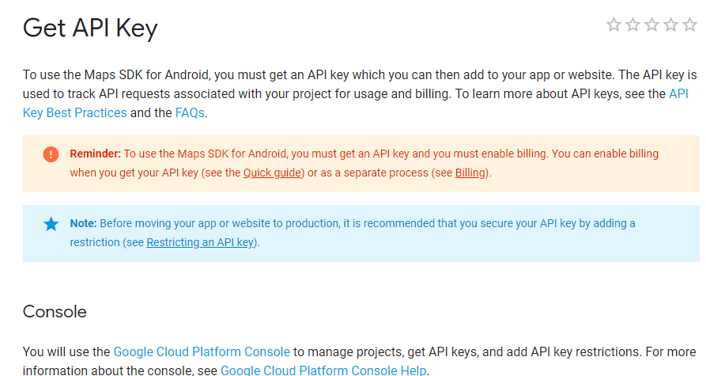
OpenSource APIs – Google Cloud & Google Map
Free on mobile

Slide 8
Thank You
Team 10 : Smart Album
with Cloud

